Slide 1
Reddit News Analysis For Stock Market Prediction
Eric Stevens

Slide 2
“Applying ML techniques to dig into large amounts of data can help discover patterns that were not immediately apparent.”
[1] Aurélien Géron, Hands On Machine Learning

Slide 3
Goal
Can we use general news stories to predict the movement of the stock market the following day?

Slide 4
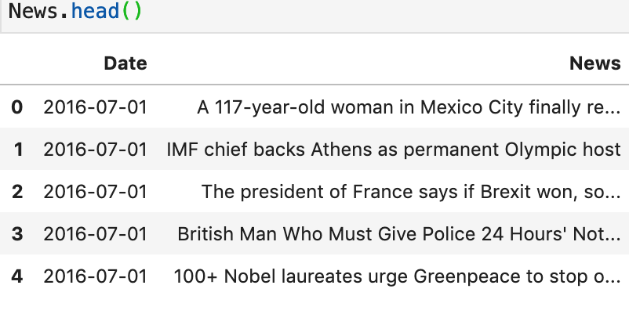
The Data - News
Top 25 news headlines from Reddit on a given date:

Slide 5
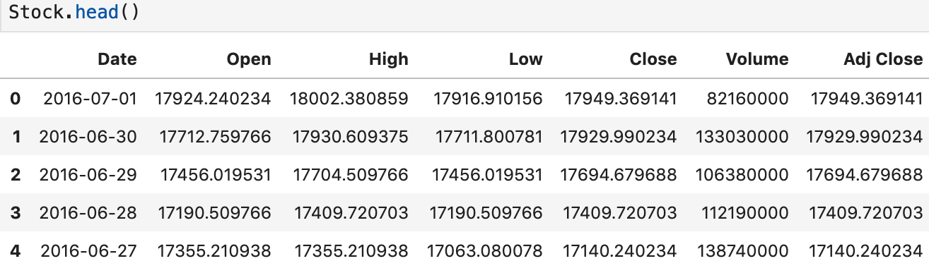
The Data - Market
Daily Dow Jones Industrial Average Statistics

Slide 6
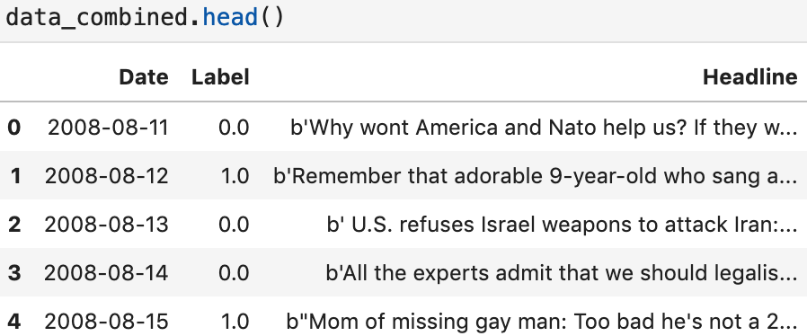
Data - Combining the datasets
The problem is reduced to a binary classification where label is 1 if the close of the current day is less than the close of the following day.

Slide 7
Data - The Label
An adjusted closing is a stock’s closing price on any given day of trading that has been amended to include any distributions and corporate actions that occurred at any time before the next days open.
The label of each observation is 1 if the adjusted closing price will be higher on the following data, 0 if it is lower.

Slide 8
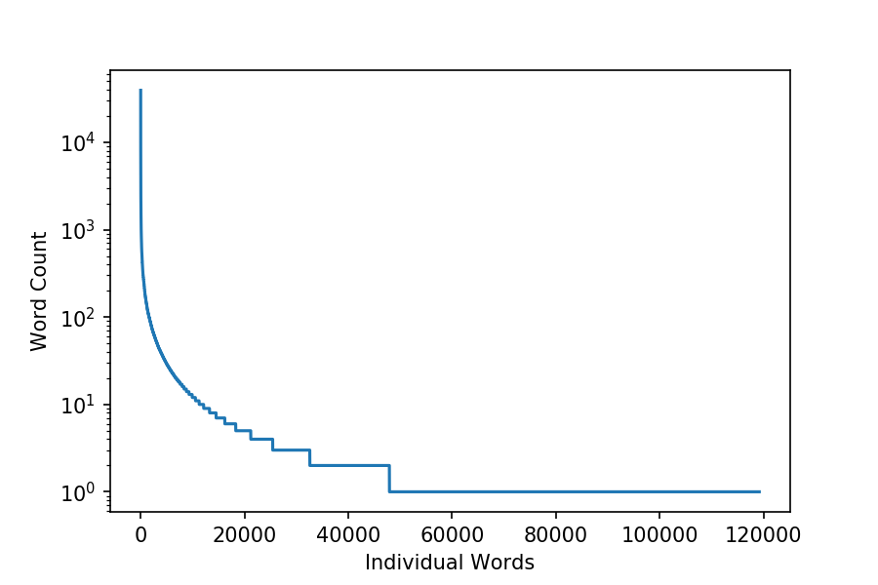
Data Analysis - word counts
Roughly 120,000 unique words in all of news headlines.
~60% of them have only a single occurrence.
Single occurrence words cannot be used for leaning.
Preprocessing will have to reduce sparsity in the data.

Slide 9
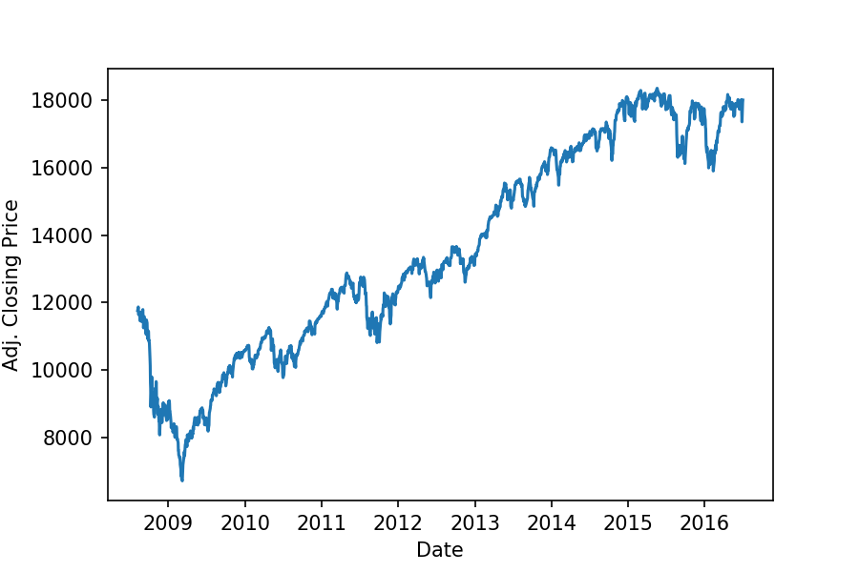
Data Analysis - stock movement
Timespan of market data roughly covers Obama presidency, a period of steady growth.
This could introduce a bias into our label data.
Reducing the problem to a binary classification problem we may be able to reduce this effect.

Slide 10
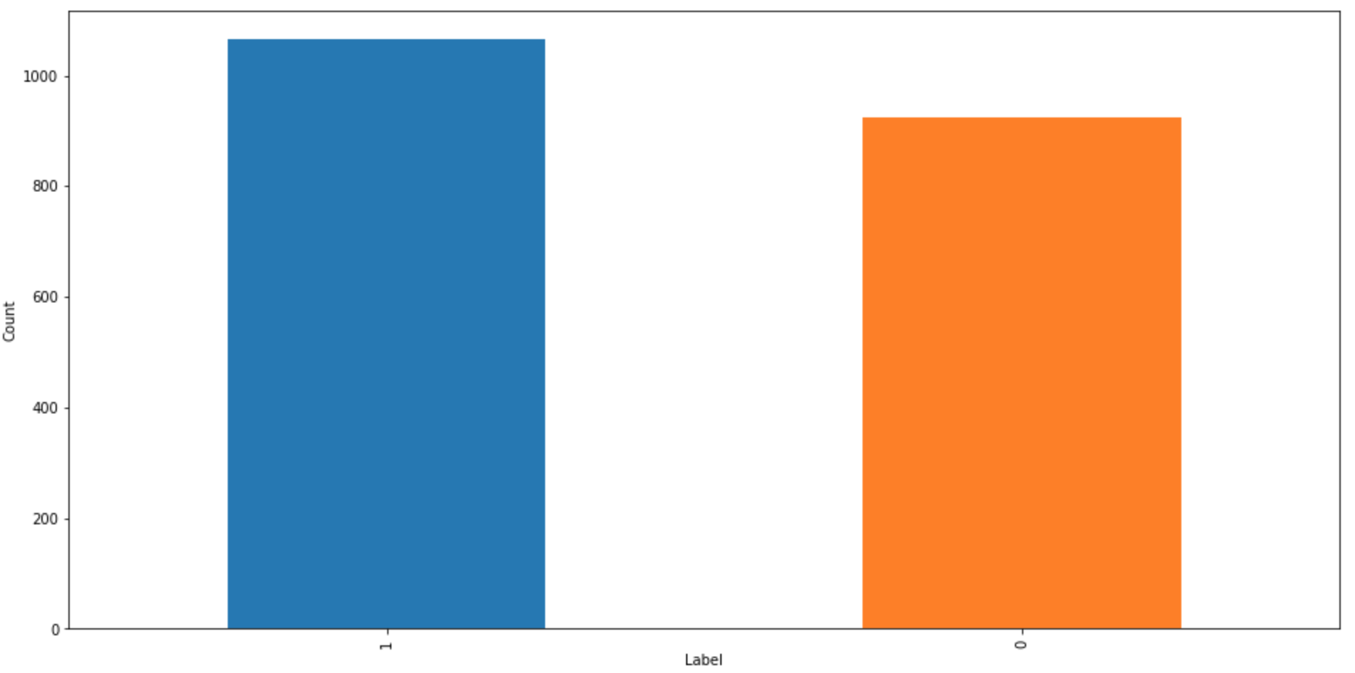
Data Analysis - label counts
Luckily there are almost an even number of labels.
This difference will only slightly influence the resulting model.

Slide 11
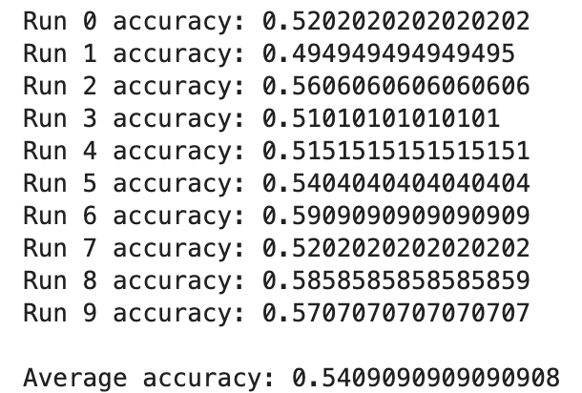
Baseline - Totally Naive
A completely naive model would just always guess ‘1’.
If we randomly shuffle the data we get a range of accuracies ranging from about 50% to about 59%.
The average accuracy ends up being around 54%.
If there is information in the data we should be able to improve on this number.

Slide 12
Building Models - data preprocessing
Case independent
Make everything lower case.
Tokenization
Using NLTK word_tokenize to split sentences up.
Stop word removal
Remove all stop words using NLTK stopword list.
Remove punctuation
Remove punctuation that has been tokenized.
Punctuation tokens will be removed but words containing punctuation such as ‘u.s.a.’ will not.
Sparsity reduction
Remove words that appear less than 100 times in the dataset.

Slide 13
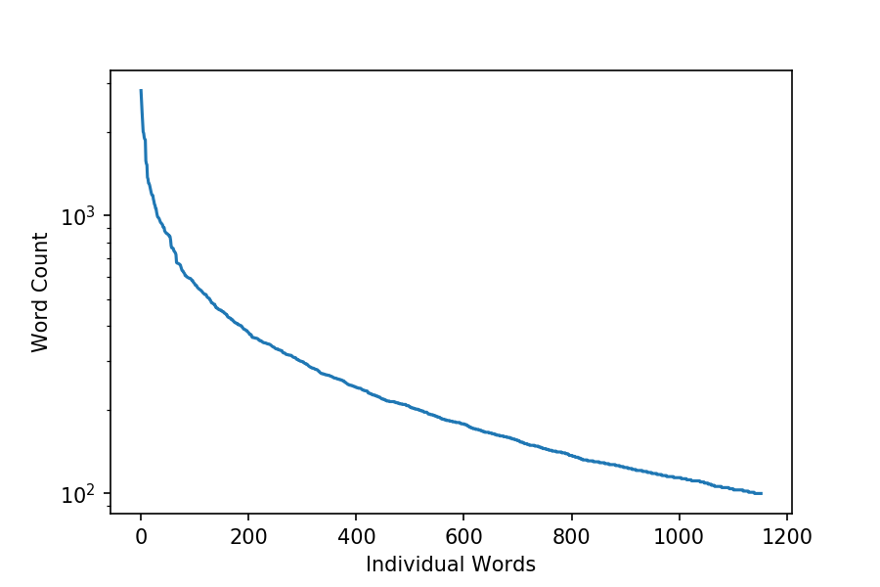
Data Preprocessing - counts
Before Preprocessing After Preprocessing

Slide 14
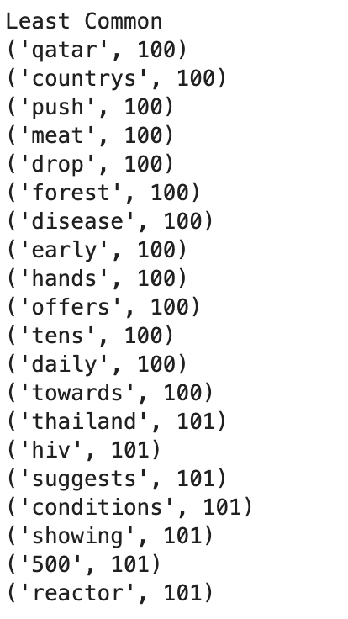
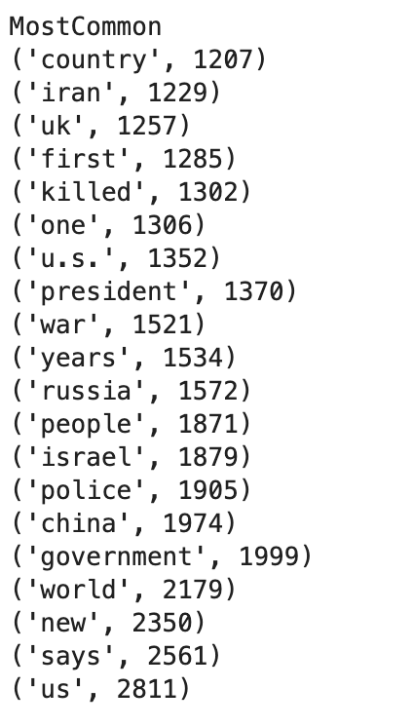
Data Preprocessing - word profile
Least common words do not appear to be too obscure.
Most of the the most common words seem to contain some information about the world.
Over seems that we will be able to extract some information about the state of the world with these words.

Slide 15
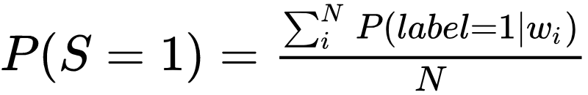

Building Models - unigram probability model
Mean of unigram probabilities in the headlines to determine label.
Conditional probability read as percent of the appearances of word w_i associated with a label of 1.
If P(S=1) >= .5, Label 1
If P(S=1) < .5, Label 0

Slide 16
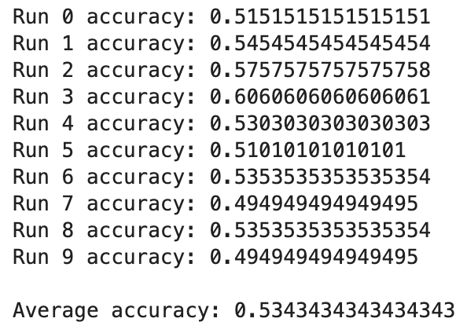
Unigram Model - performance
Range of 50% to 60% performance.
Average performance of 53%.
Suspiciously close to totally naive solution.
Even a little worse in this case.

Slide 17
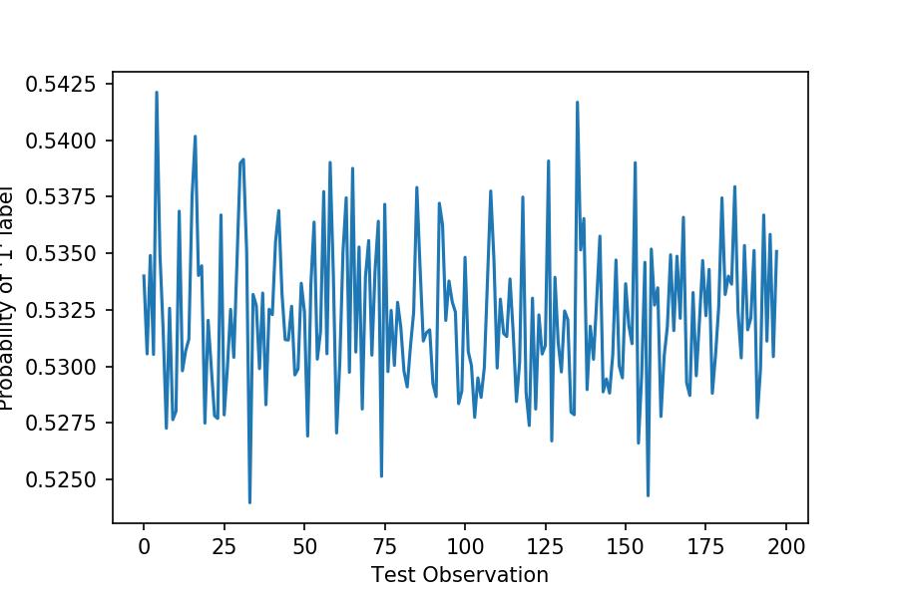
Unigram Model - the issue
All probabilities for all collections of headlines are between the range of .525 and .5425.
Highly regular but results in a guess of label ‘1’ every time.
Equivalent to the totally naive method.

Slide 18
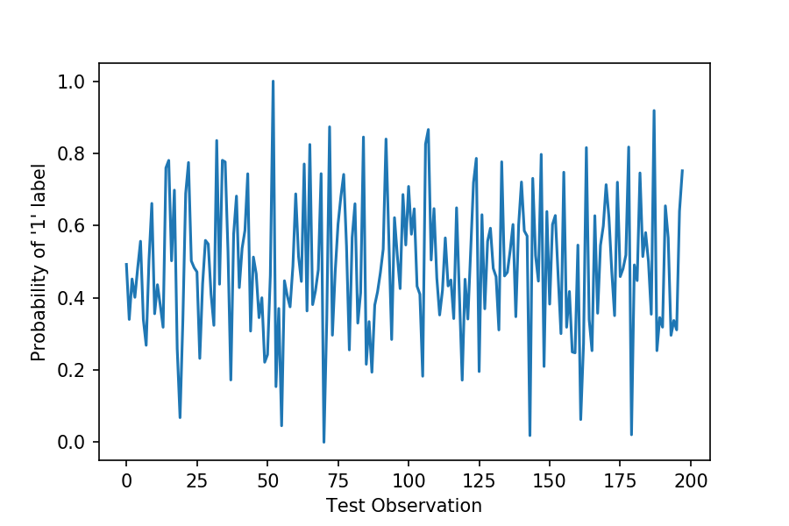
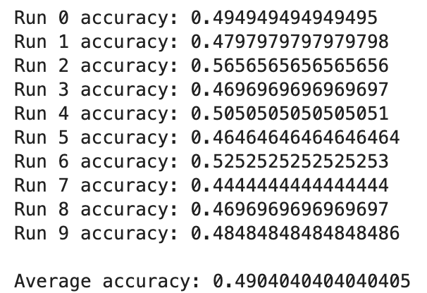
Unigram Model - normalize (last ditch effort)

Slide 19
Switch to data science packages
Tf-idf vectorization
Similar to the count based method used above.
Will be used as the text representation for the package models.
Allows for n-gram vectorization
Logistic regression
Discriminative model, more powerful than the unigram probability.
Great for classification problems.
LSTM
Powerful model for time series data.
Better performance with order dependent relationships than n-grams.
Don’t have nearly enough data, but if all else fails.

Slide 20
Tf-Idf Vectorization
A minimum document frequency set to 100 is similar to the minimum occurrence value set to 100 in the unigram model.
Stop words are still removed.
N-grams for 1-4 are now all considered.
[2] Multi-Class Text Classification with Scikit-Learn, Susan Li

Slide 21
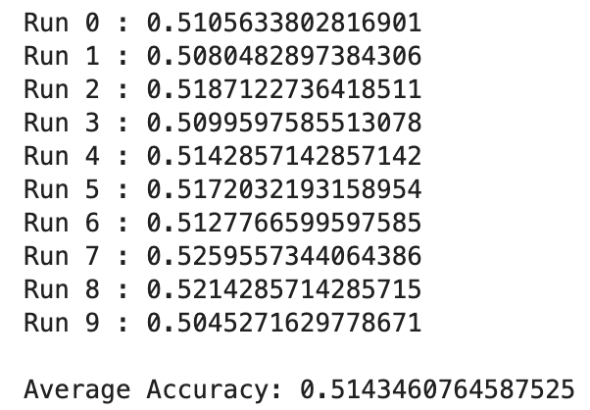
Logistic Regression
Similar to original effort, relying on max likelihood type model.
Because of the vectorization, will take into account n grams from 1 to 4.
Still nothing

Slide 22
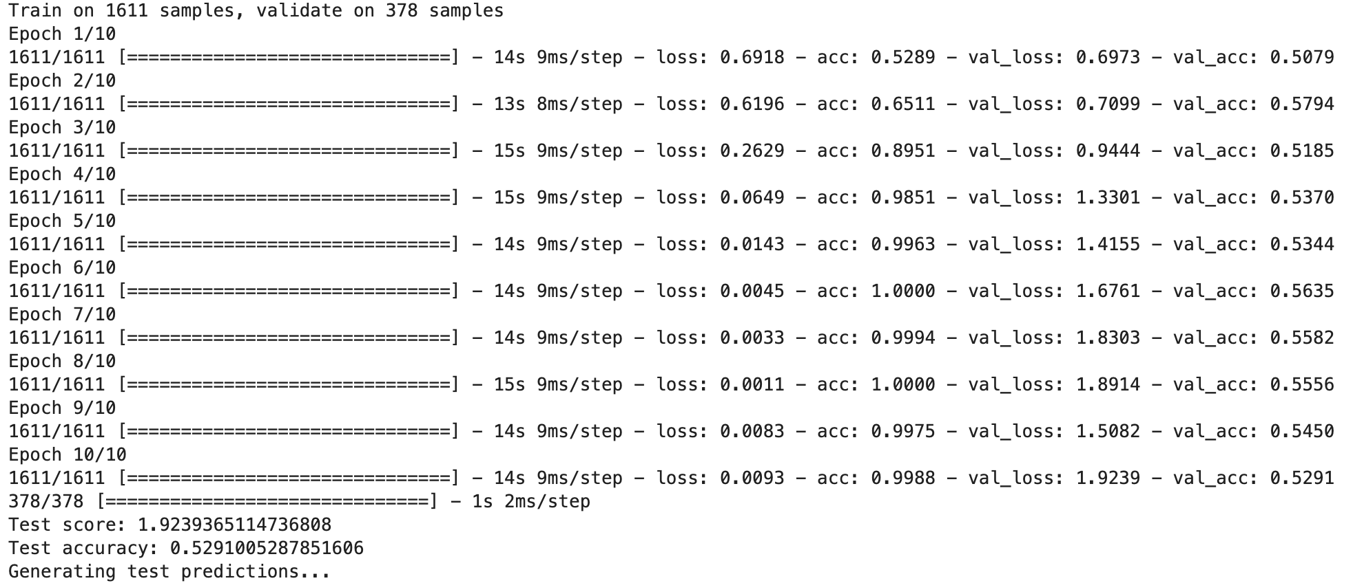
LSTM (“hail-mary”)
[3] Use News to Predict Stock Market, Kaggle:Iseiyjg

Slide 23
What Went Wrong?
Bad Idea?
Reddit news headlines do not necessarily contain any actionable information about the stock market.
The stock market in notoriously unpredictable in general. Trying to derive a trading signal from random news data adds another layer of complexity.
User error
I am not as skilled with these tools or this methodology as I would like to be.
Bad dataset
The data was probably way too small to allow for the learning that would be needed to boost the signal strength.
Reddit news was a bad choice, stock market news wires would have drastically reduced the noise in the data.

Slide 24
Thank You
References:
Hands-On Machine Learning with Scikit-Learn & TensorFlow, Aurélien Géron, ISBN-10: 1491962291
Multi-Class Text Classification with Scikit-Learn, Susan Li, https://towardsdatascience.com/multi-class-text-classification-with-scikit-learn-12f1e60e0a9f
Use News to predict Stock Markets, Kaggle:Iseiyjg https://www.kaggle.com/lseiyjg/use-news-to-predict-stock-markets

